Slide 1
MIKE 11
Results Viewing

Slide 2
RESULTS VIEWING
Results Files and MIKE VIEW
Setting up and
running simulation
in MIKE Zero
Result files
Viewing and MIKE VIEW
extracting results Result Viewer
MIKE 11
SIMULATION
MIKE 11 (.res11)
MIKE 1D (.res1d)

Slide 3
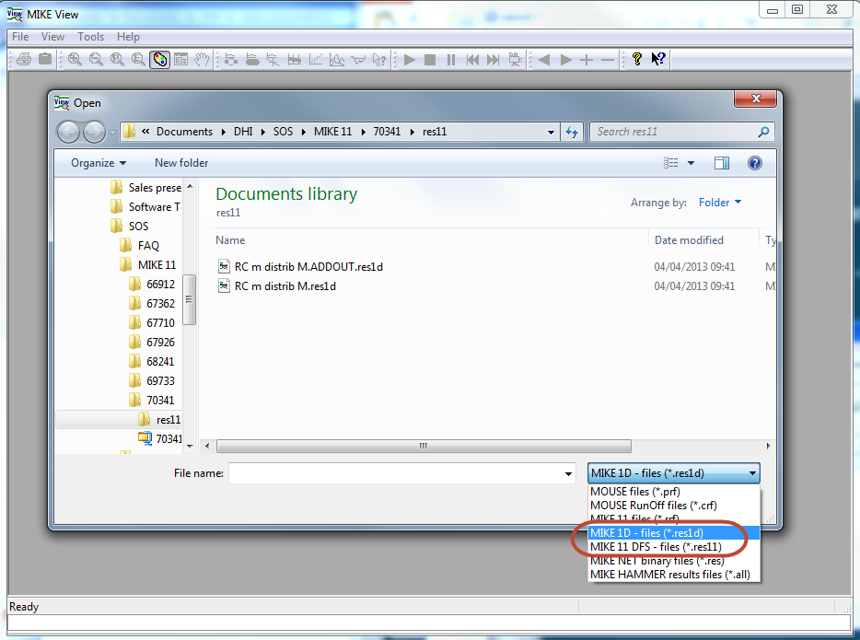
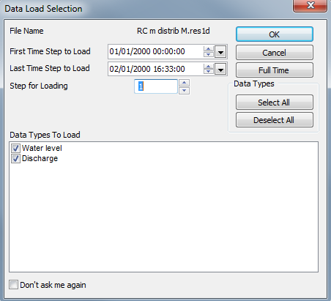
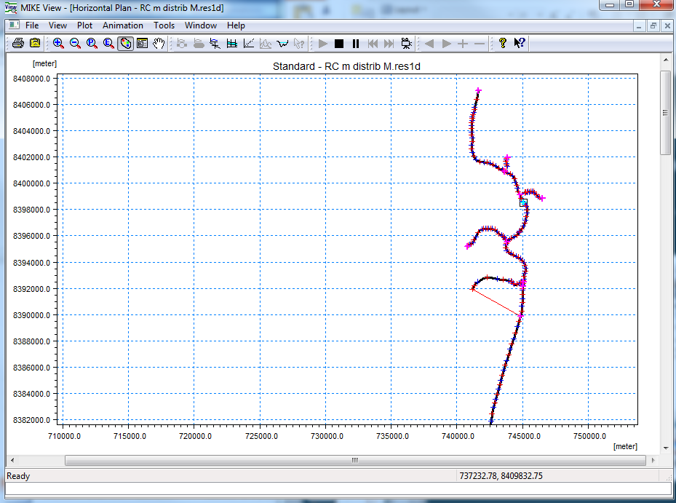
MIKE VIEW
MIKE 11 Results Files (.res11 and .res1d)
How? Start -> MIKE by DHI 20xx -> MIKE View -> MIKE View

Slide 4
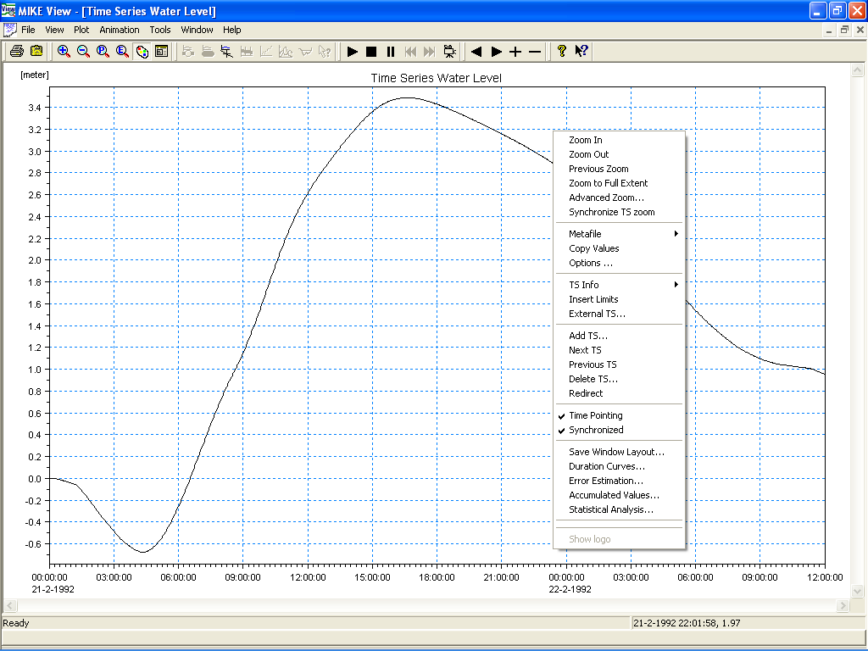
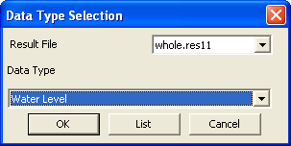
MIKE VIEW
Plot time series at gridpoints
How? MIKE View -> Plot -> TS in Gridpoints
Add Multiple Series Using Right Click or Icons
Select Gridpoint
Mouse Location Selection
(Water Level or Discharge)

Slide 5
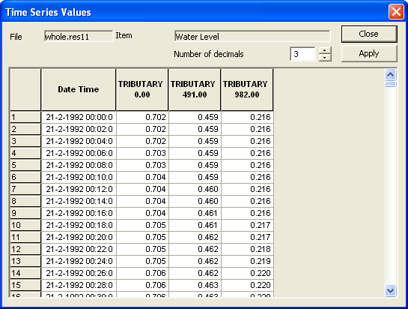
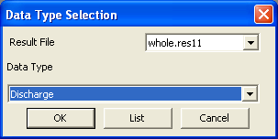
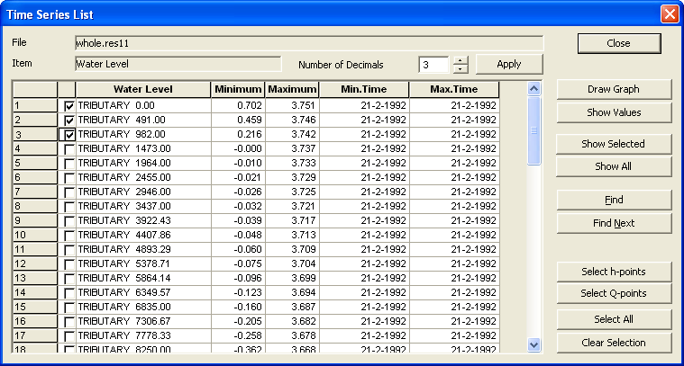
MIKE VIEW
Plot time series at gridpoints
How? MIKE View -> Plot -> TS in Gridpoints
Select Gridpoint
Tabular Data (Copy to External Software)
Summary Data for
All Gridpoints (Max/Min)

Slide 6
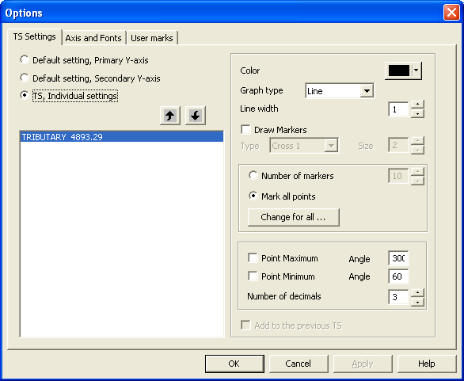
MIKE VIEW
Time Series View Options (TS Settings)
How? Time Series -> Right Click (Options)
Change the Appearance of Plotted Data

Slide 7
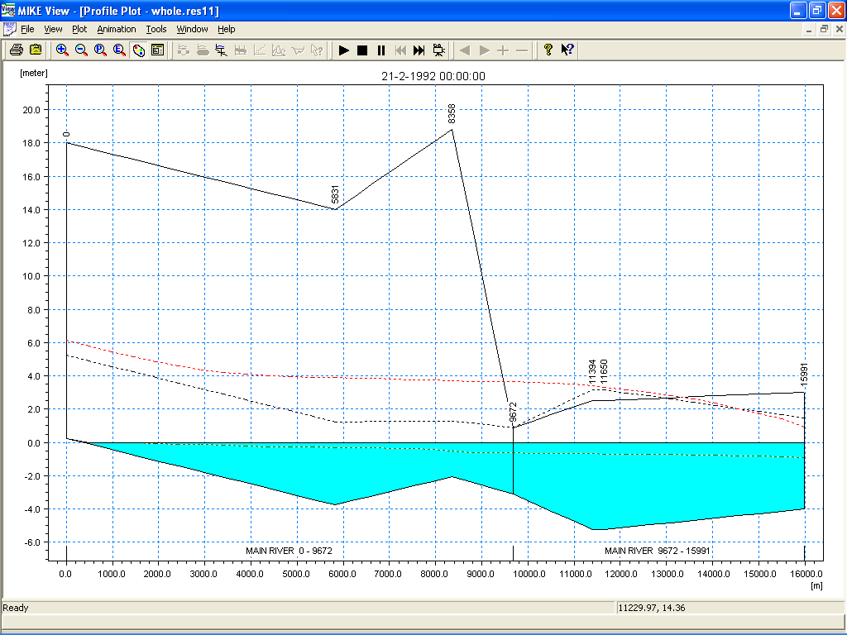
MIKE VIEW
Plot longitudinal profile of the river
How? MIKE View -> Plot -> Longitudinal Profile
Use SHIFT-Click and CTRL-Click to Control Profile Selection
Use Mouse to Pick Branches
Animate Water Surface
MIKE 11 Bank Markers
(1, 2 & 3) Define Invert
and Bank Profiles (L & R)
Max Level (Dotted Red)
Notes:
Ctrl: stops the profile
Shift: unselects a branch

Slide 8
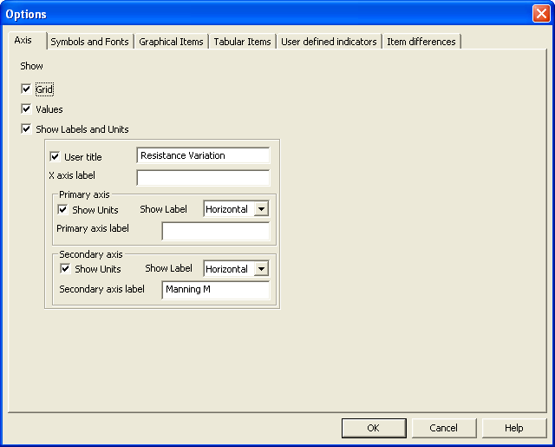
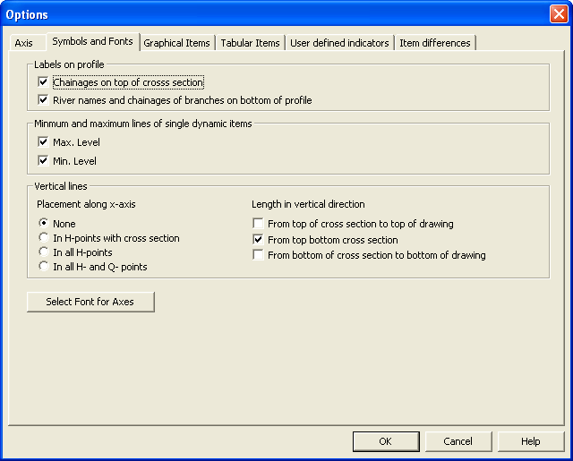
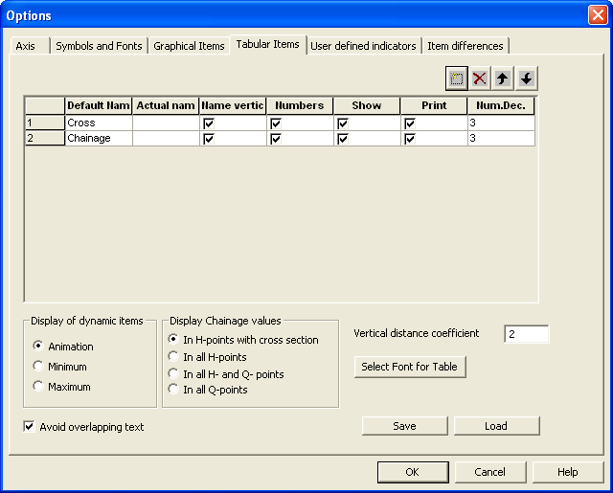
MIKE VIEW
Longitudinal Profile Options (Axis)
How? Longitudinal Profile -> Right Click (Options)
Navigate through the different tabs

Slide 9
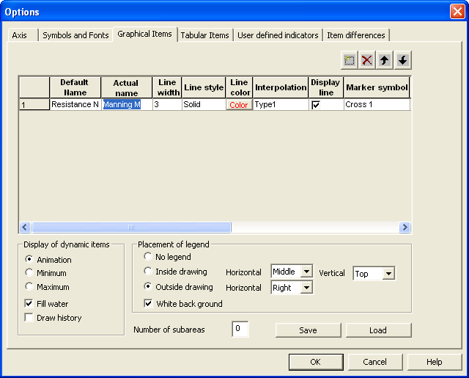
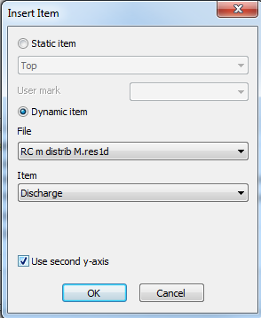
MIKE VIEW
Longitudinal Profile Options (Graphical Items)
How? Longitudinal Profile -> Right Click (Options)
Add and animate multiple items and change display properties
Click here to add more items to be plotted on the profile

Slide 10
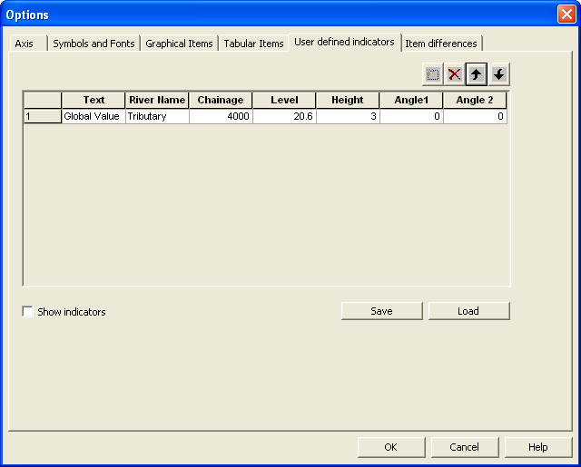
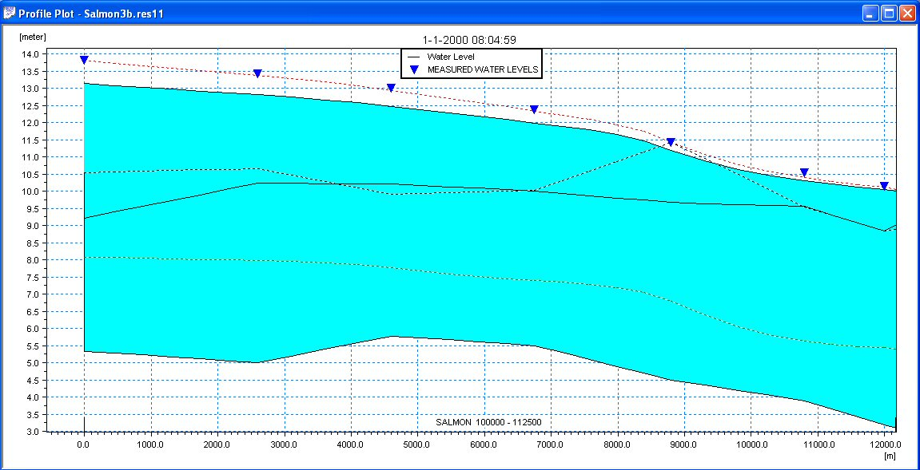
MIKE VIEW
Longitudinal Profile Options (User Defined Indicators)
How? Longitudinal Profile -> Right Click (Options)
User defined indicators can be used to display calibration marks for example or to add annotations to the plot and highlight data.

Slide 11
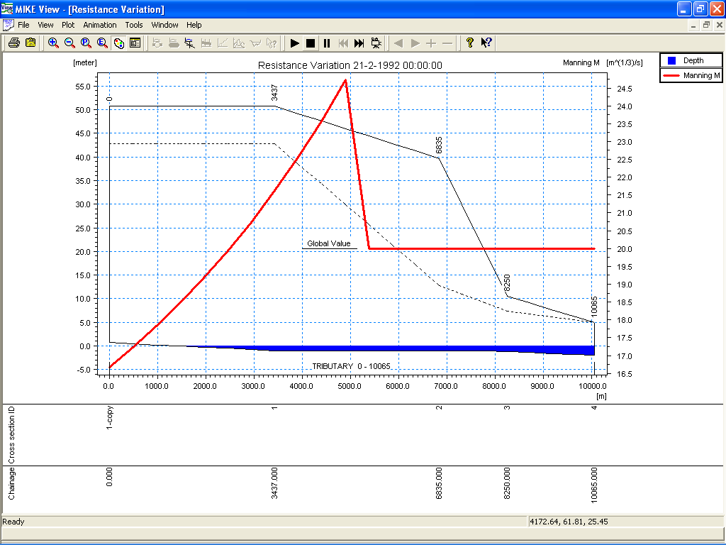
MIKE VIEW
Customise Longitudinal Profiles
Create and Save
Customised Plots

Slide 12
MIKE VIEW
Q-H Curve
How? MIKE View -> Plot -> Q-H Curve
Draw Corresponding Time Series

Slide 13
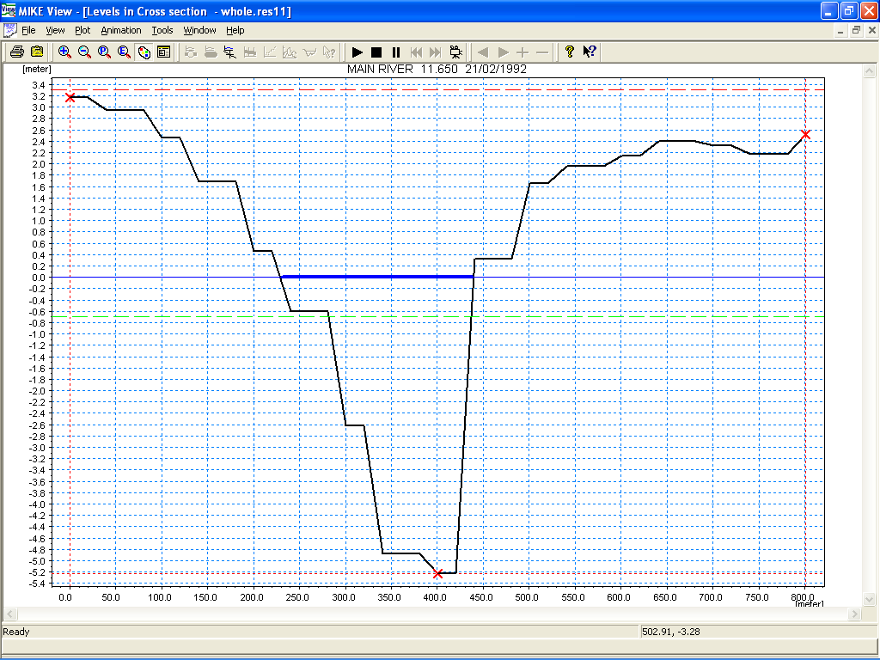
MIKE VIEW
Cross Sections
How? MIKE View -> Plot -> Cross sections
Select Location with Mouse
MIKE 11 Bank Markers
Displayed
Minimum/Maximum
Levels Displayed
Animate Water Level

Slide 14
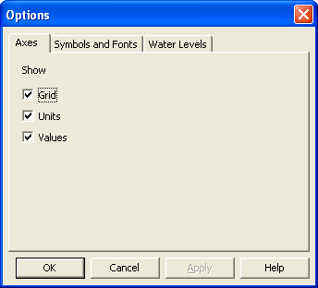
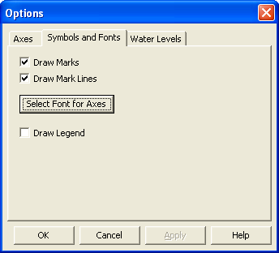
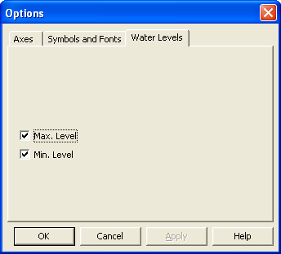
MIKE VIEW
Cross Section View Options
How? Cross Section -> Right Click (Options)
Change Simple Display Settings Only

Slide 15
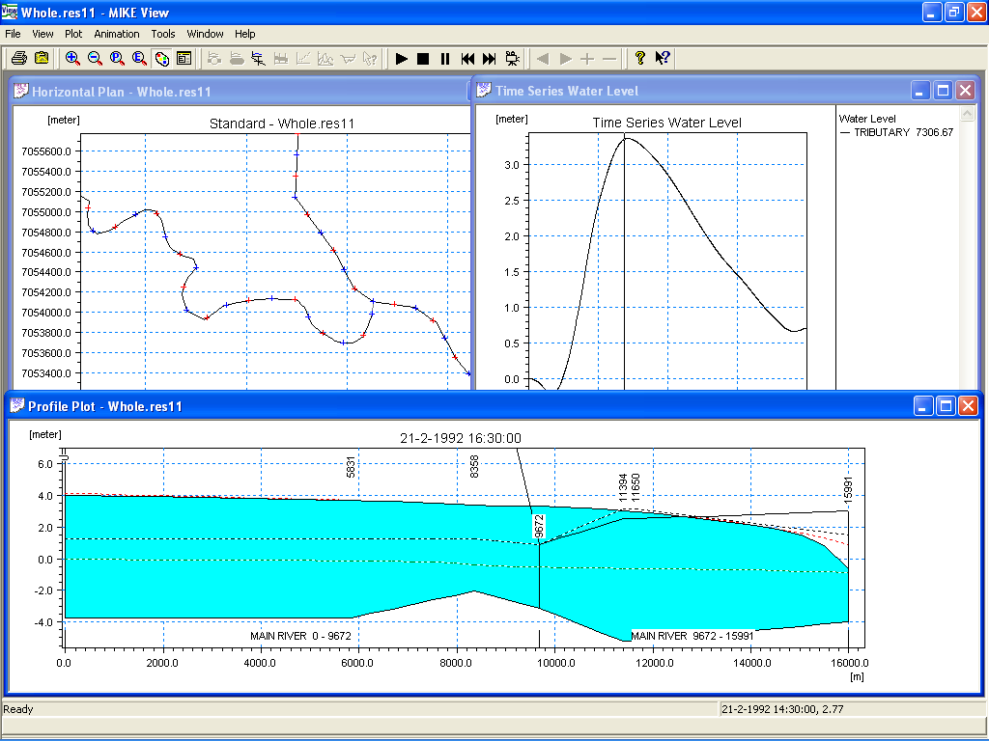
MIKE VIEW
Synchronise Plots and Animations
All Animations
are Synchronised

